Slide 1
COVID-19 INDONESIA
Lecture: Fepri Putra Panghurian (D6198)
Class: LE01
ALBERT - 2201738384
DERICK YUDANEGARA - 2201740565
ARIQ RAMADHAN - 2201743604
DARREN - 2201759930
REYNALDO SINCAR PRATAMA - 2201742040

Slide 2
WHAT IS COVID-19

Slide 3
OVERVIEW
Coronavirus disease (COVID-19) is an infectious disease caused by a newly discovered coronavirus.
Most people infected with the COVID-19 virus will experience mild to moderate respiratory illness and recover without requiring special treatment. Older people, and those with underlying medical problems like cardiovascular disease, diabetes, chronic respiratory disease, and cancer are more likely to develop serious illness.
The best way to prevent and slow down transmission is be well informed about the COVID-19 virus, the disease it causes and how it spreads. Protect yourself and others from infection by washing your hands or using an alcohol based rub frequently and not touching your face.

Slide 4
OVERVIEW
The COVID-19 virus spreads primarily through droplets of saliva or discharge from the nose when an infected person coughs or sneezes, so it’s important that you also practice respiratory etiquette (for example, by coughing into a flexed elbow).
At this time, there are no specific vaccines or treatments for COVID-19. However, there are many ongoing clinical trials evaluating potential treatments. WHO will continue to provide updated information as soon as clinical findings become available.

Slide 5
PREVENTION
Wash your hands regularly with soap and water, or clean them with alcohol-based hand rub.
Maintain at least 1 metre distance between you and people coughing or sneezing.
Avoid touching your face.
Cover your mouth and nose when coughing or sneezing.
Stay home if you feel unwell.
Refrain from smoking and other activities that weaken the lungs.
Practice physical distancing by avoiding unnecessary travel and staying away from large groups of people.

Slide 6
SYMPTOMS
Fever.
Dry cough.
Tiredness.
Difficulty breathing or shortness of breath.
Chest pain or pressure.
Loss of speech or movement.

Slide 7
FIRST CASE IN INDONESIA
Two women living in Depok, West Java was conﬁrmed positive with COVID-19 because had a contact with a Japanese man coming from Malaysia who was already infected with the virus several days before.
Since then, the virus kept on spreading throughout Indonesia and infect thousands more
https://jakartaglobe.id/news/indonesia-confirms-first-coronavirus-cases-in-its-territory/

Slide 8

INDONESIA COVID-19 DATA

Slide 9
LINK
https://bit.ly/3eLkXcY

Slide 10
WHAT
Data Studio is Google’s reporting solution for power users who want to go beyond the data and dashboards of Google Analytics. The data widgets in Data Studio are notable for their variety, customization options, live data and interactive controls (such as column sorting and table pagination).

Slide 11
WHY
With Google Data Studio it gives an easy way to visualize data with lot of data source format. We can also make a dynamic and interactive report. Google Data Studio save us time for creating and sharing the report in the team. We can create and share our report in real-time.

Slide 12
DATA SOURCE
https://datahub.io/core/covid-19
https://covid19.go.id/peta-sebaran
https://konfirmasitimes.com/2020/05/31/update-virus-corona-31-meiindonesia/

Slide 13
DATA SET
In this Covid-19 In Indonesia data project, we used 3 different datasets to shows every data in each datasets.

Slide 14
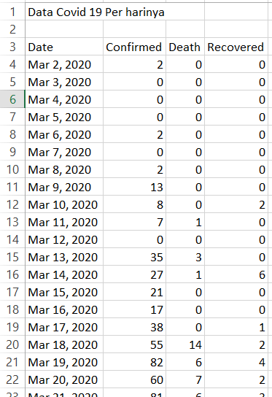
DATA SET 1
This dataset is a dataset to find out the number of C / D / R based on the date of each day. In other words, each date shows on that date, how many new cases C / D / R in Indonesia.
In this data set, there are several columns consisting of
Date
Confirmed ( Covid-19 Confirmed Amount )
Death ( Number of Death )
Recovered ( Total Cured of Covid-19 )

Slide 15
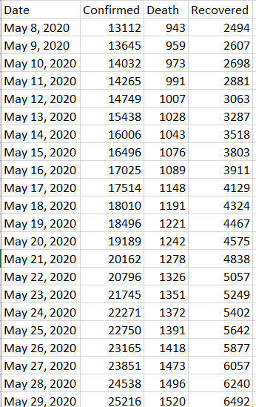
DATA SET 2
In this second data set, shows the C / D / R data in Indonesia on covid-19. This data set is different from dataset 1, because in dataset 2, it shows the amount total of C / D / R of Covid-19 until that date. So basically, the data on the current date, was taken from yesterday data and added with the new C/D/R data on the current date. The columns in this dataset are :
Date
Confirmed (Covid-19 Confirmed Amount)
Death (Number of Death)
Recovered (Total Cured of Covid-19)

Slide 16
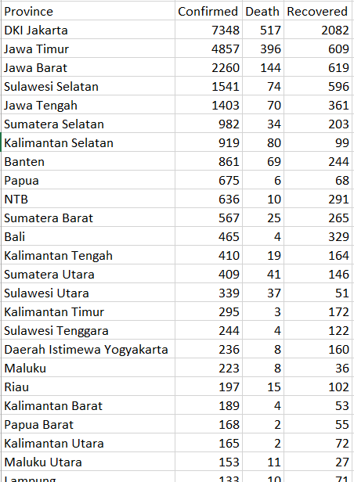
DATA SET 3
In the third dataset, contains the total data of C / D / R of covid-19 in each province from Indonesia. The data displayed, is the total data until 31st of May 2020.
The columns in this dataset are :
Province
Confirmed (Covid-19 Confirmed Amount)
Death (Number of Death)
Recovered (Total Cured of Covid-19)

Slide 17
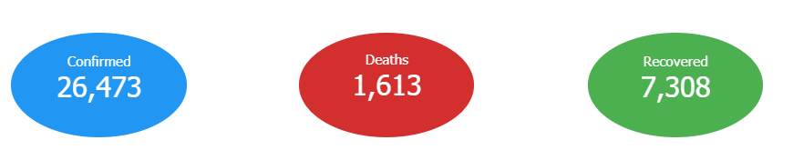
INDONESIA CORONA VIRUS DATA

Slide 18
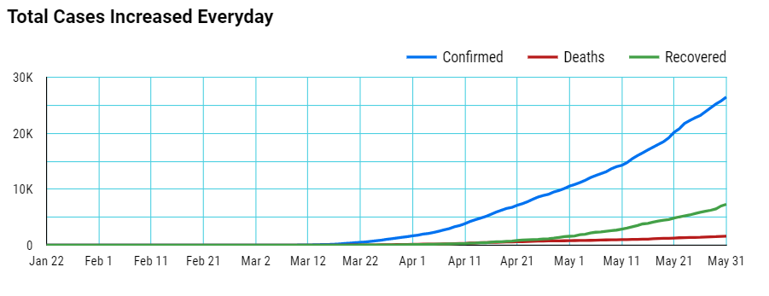
Indonesia

Slide 19
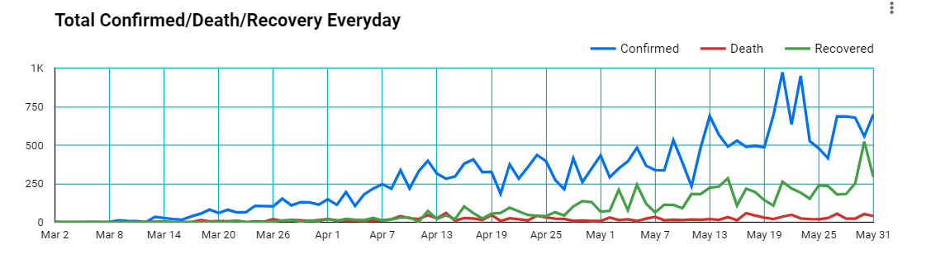
Indonesia

Slide 20
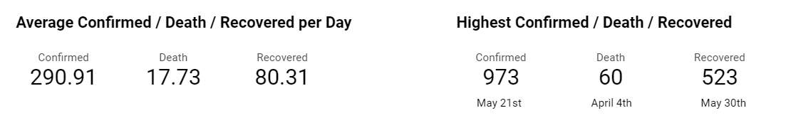
Indonesia

Slide 21
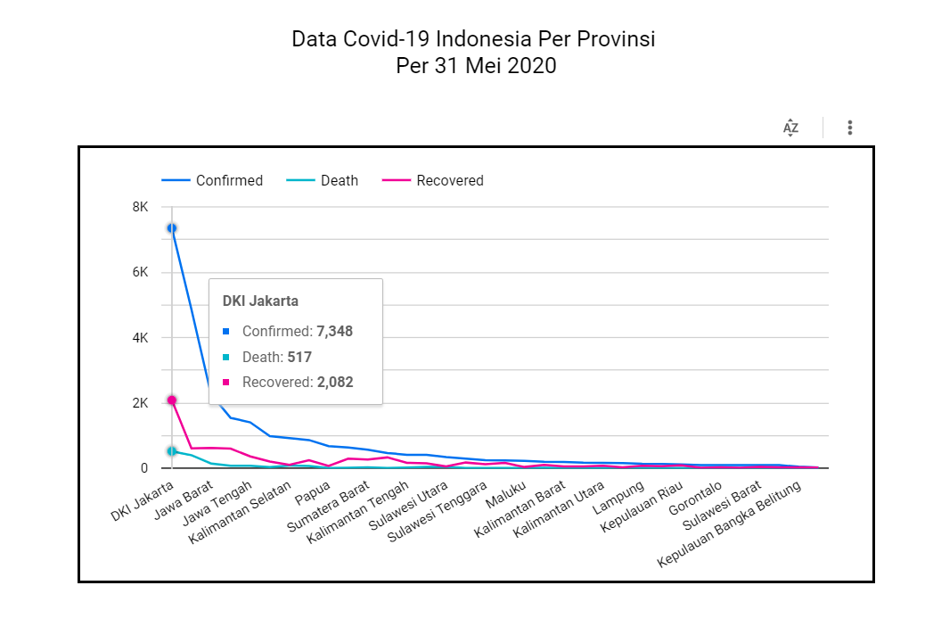
This data shows total of C/D/R for each province in Indonesia.
The data shown with Graphical Visualization for each Province and Sorted Descendingly by the total Confirmed Cases.

Slide 22
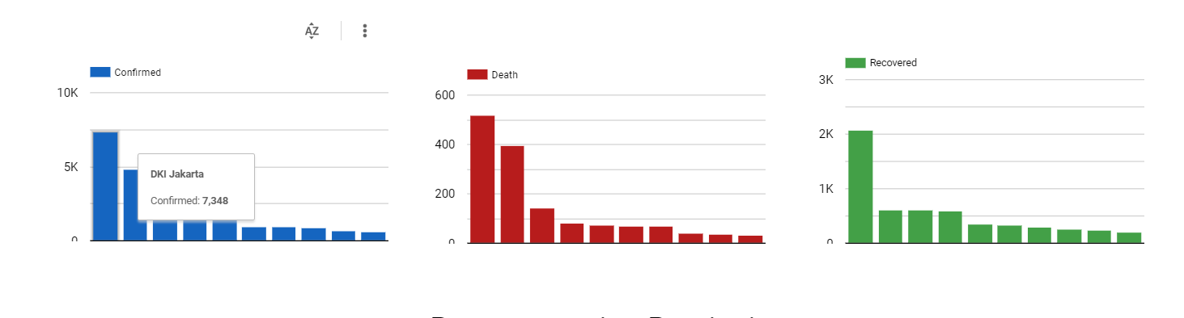
Bar Chart
This is an individual representation of C/D/R for each province with Bar Chart Data Visualization.

Slide 23
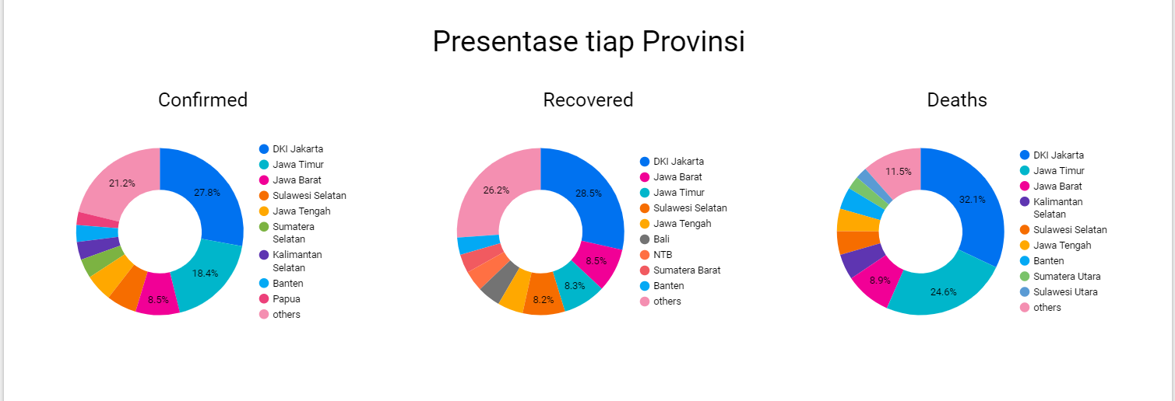
Pie Chart (Percentage)
This is an individual representation of C/D/R for each province with Pie Chart Data Visualization. And also this data visualization shows the cases percentage of each province.

Slide 24
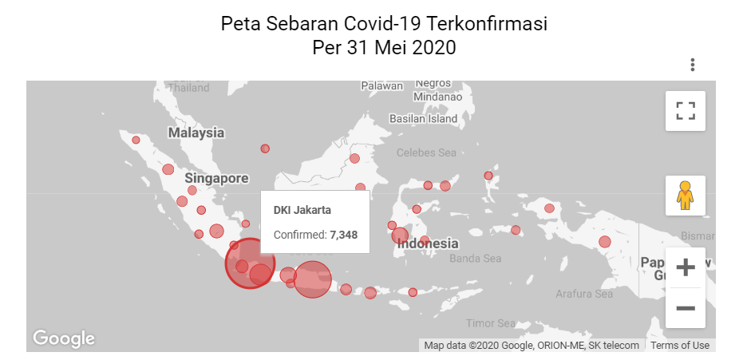
Map Visualization
This is an additional data, the map data visualization. It shows the confirmed cases in each province with the red circle heatmap. The red circle heatmap size, indicating the total of confirmed cases in each province. Larger size of heatmap means higher total of confirmed cases.

Slide 25
THANK YOU

